Slide 1
IndAiGenious Manual
Application URL- IndAiGenious
Recommended Browser- Google Chrome
For Voice interaction use of headphones is recommended

Slide 2
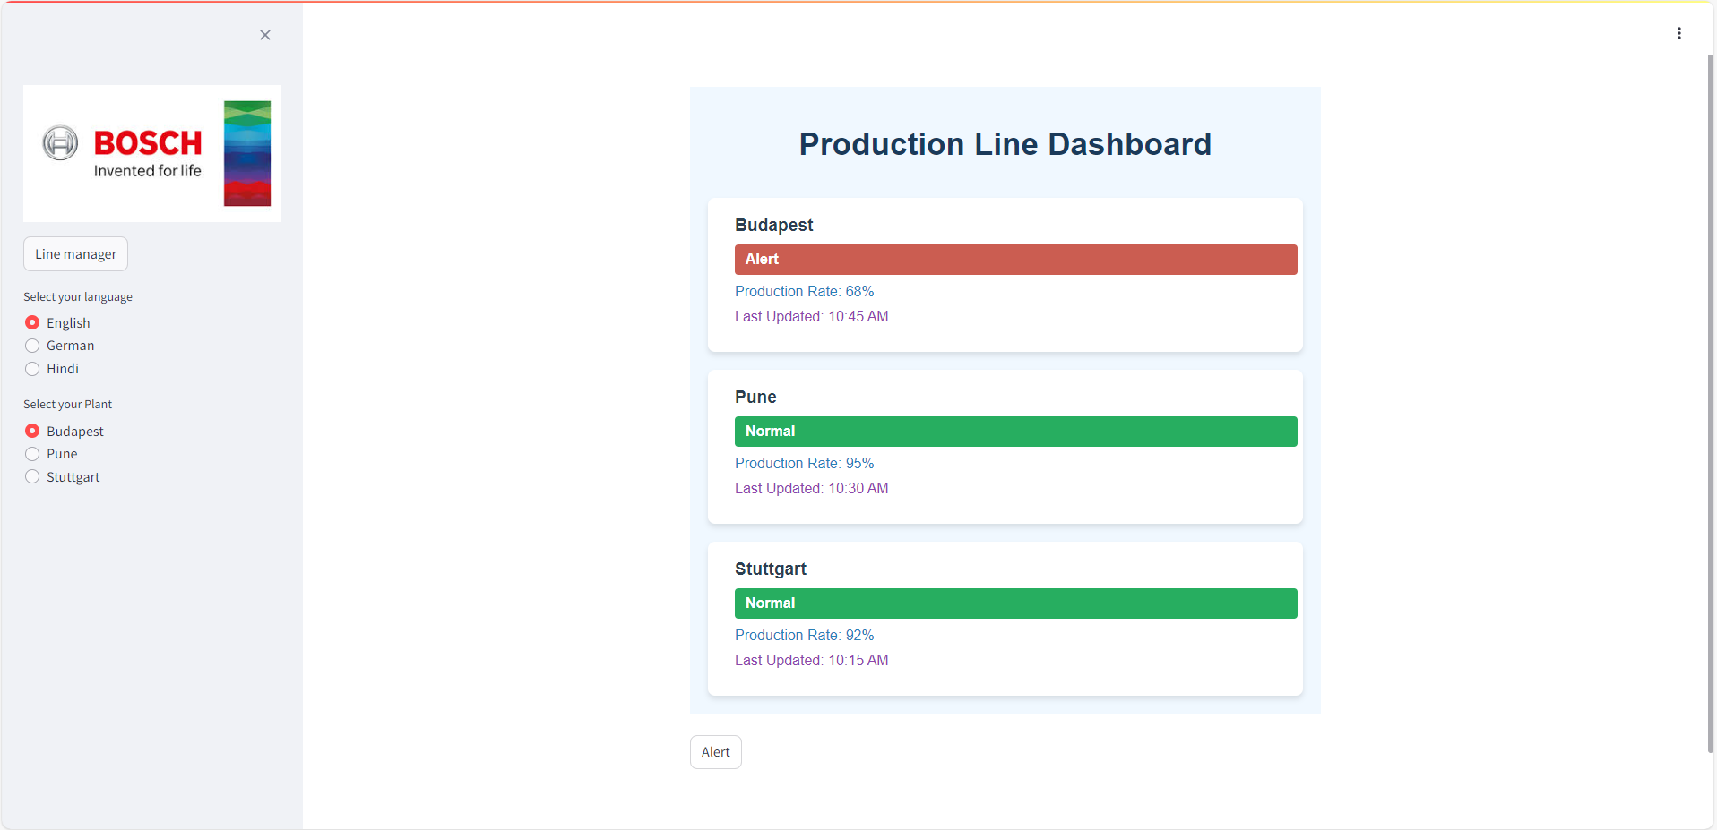
Landing Page
User manual
Click here to go to the Alert page

Slide 3
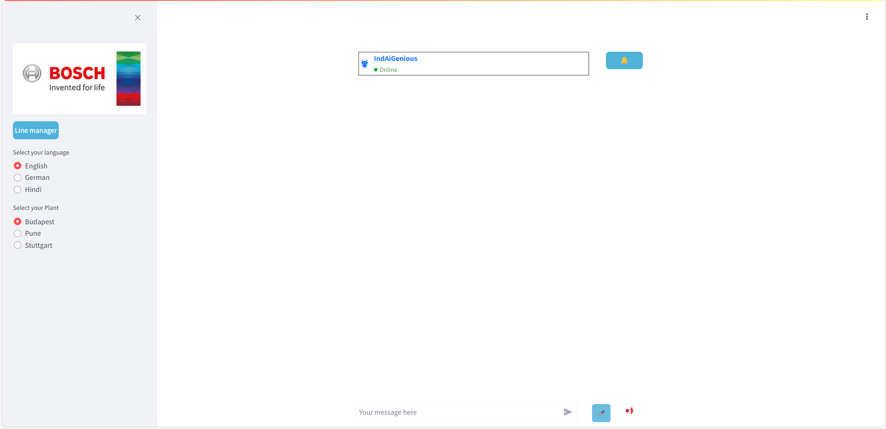
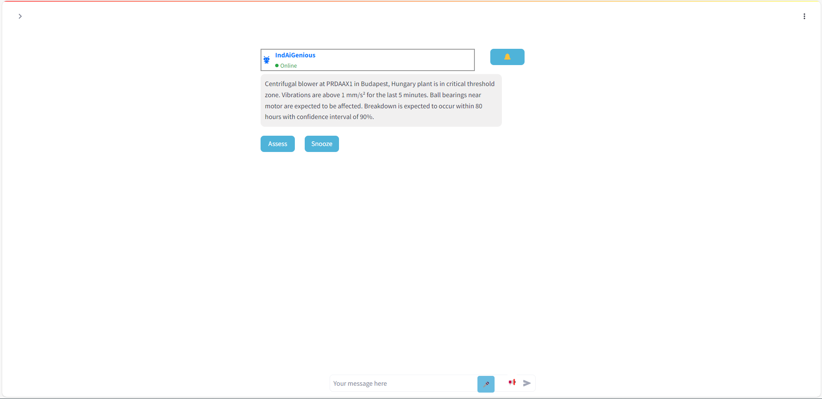
Alert page with Chat and Voice options
User Manual
Click here for Notifications
Notifications can be viewed here

Slide 4
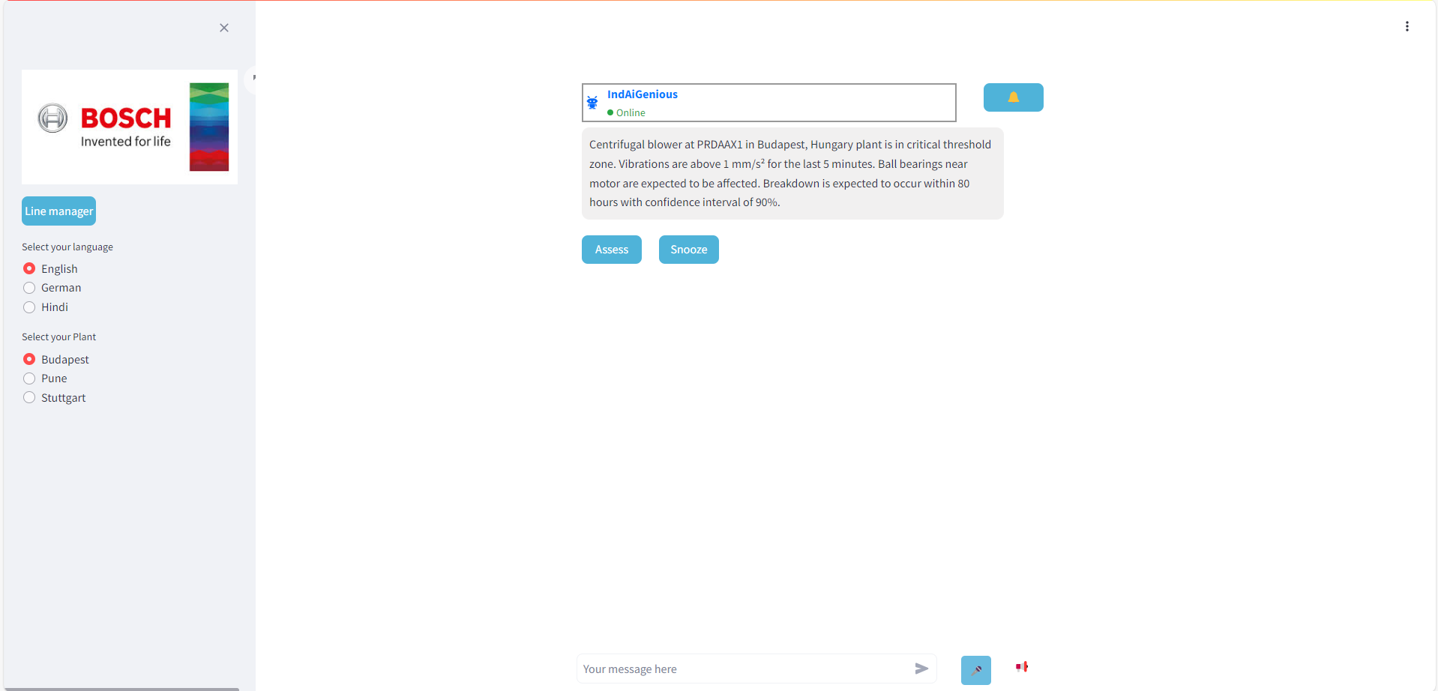
Alert page with Chat and Voice options
User manual
Choose Language of interaction for Voice and chat
Type in your queries here in your choice of languages from provided options
Click on mic button to use voice input
Click on for speaker icon for system to speak post response generation

Slide 5
Thank You

